Slide 1
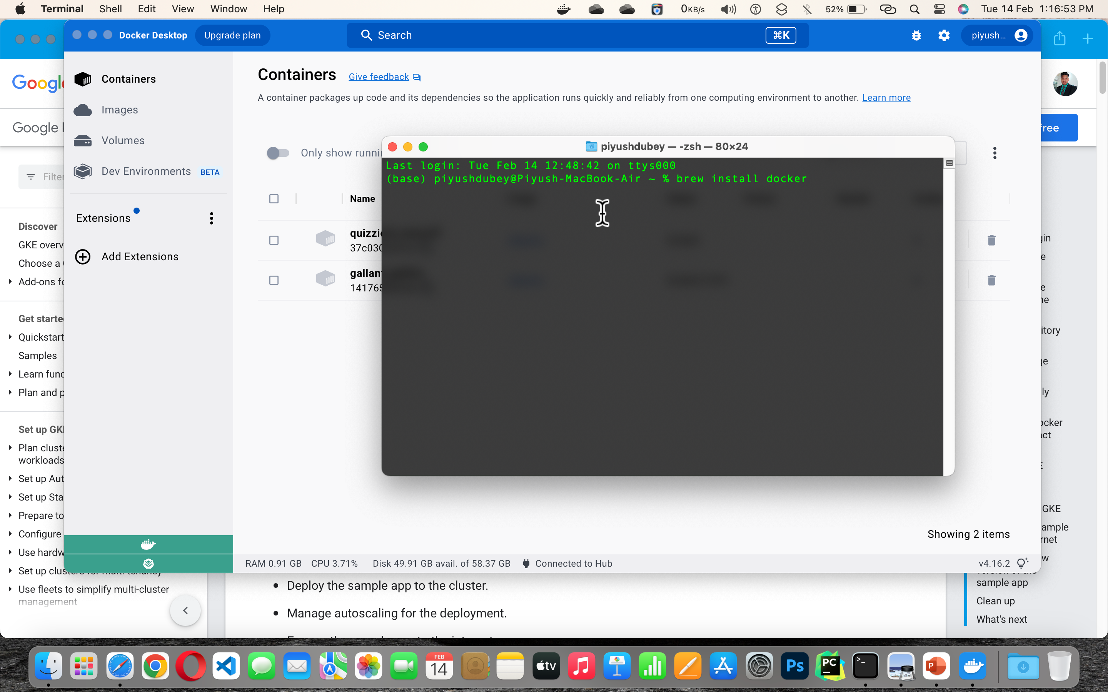

Q1.
a) Write the command to install Docker.[2]
In mac the code to install docker is brew install docker , although I had already installed so I will not execute it again and I will show the version instead

Slide 2
Q1.
b) Create a container.[2]
I created a container of ubuntu image which I pulled earlier.

Slide 3
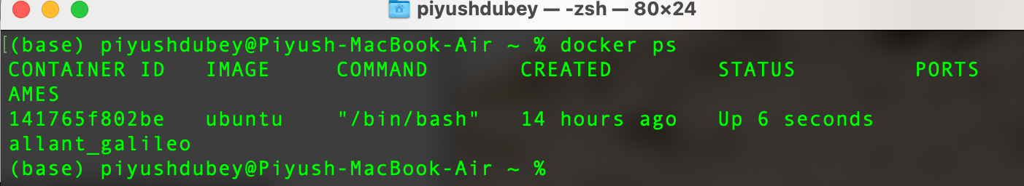
Q1.
c) List all the running containers.[5]
The container which I created of ubuntu image

Slide 4
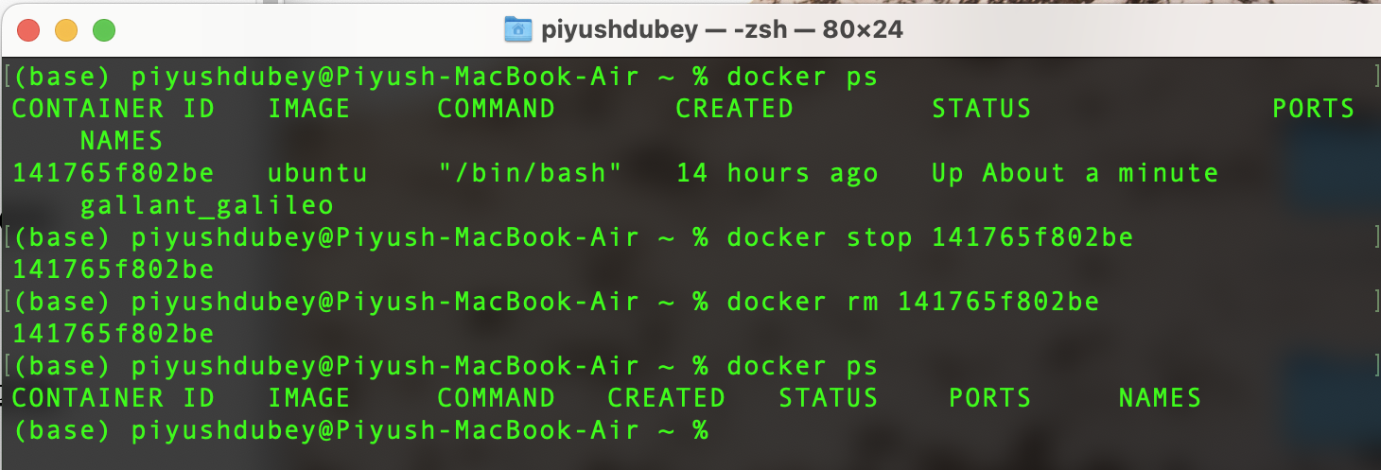
Q1.
d) To remove a container from the system.[1]
First we have to stop the container then we can remove the image using rm or rmi , in case forced.

Slide 5
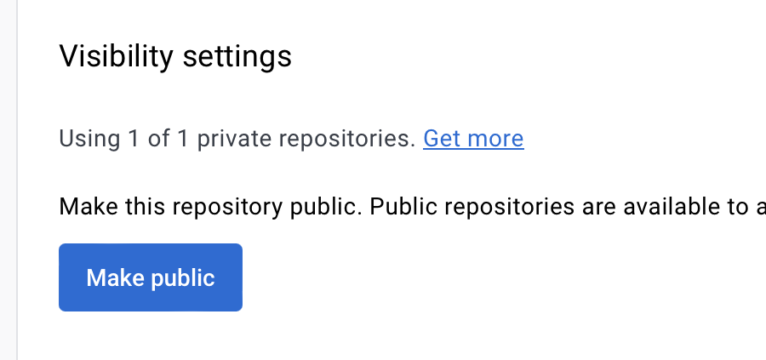
Q1.
e) Change the rights on an image from public to private in docker hub.[5]
You can see that I have made the repo private from the settings in docker hub , and now it is showing private

Slide 6
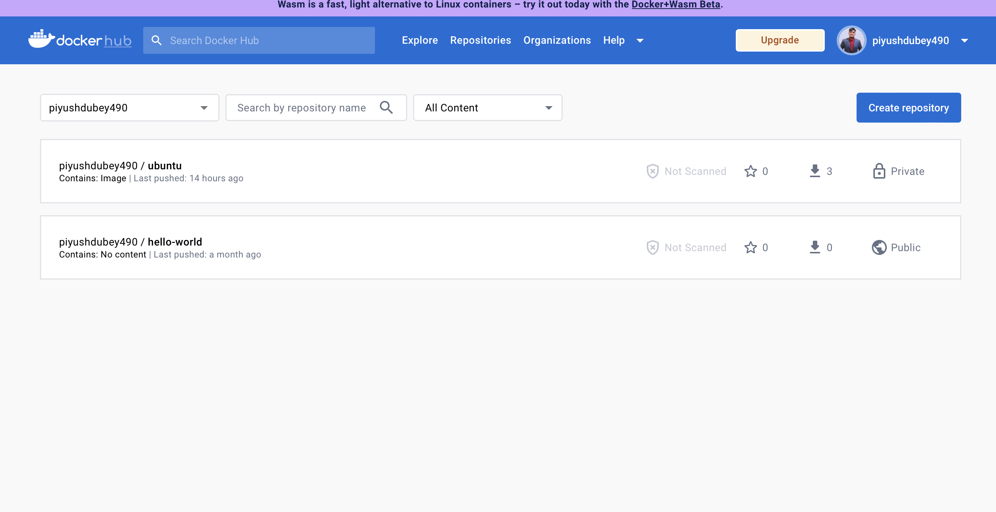

Slide 7
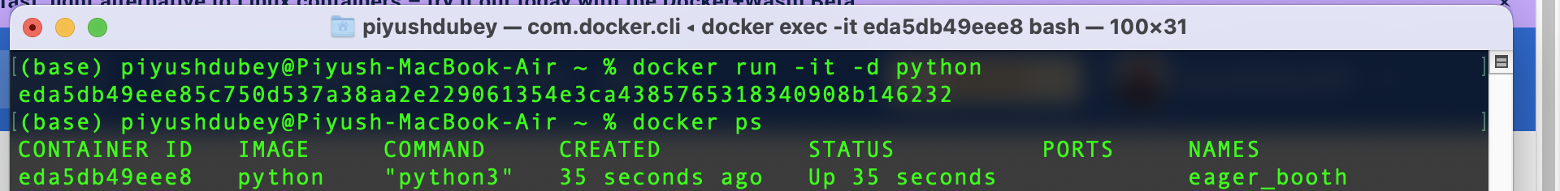
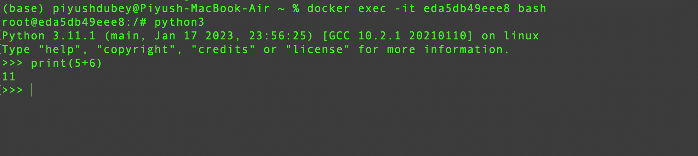
Q1.
f) Login into or access a container.[5]
I have executed the container of python image , and then I accessed it and wrote a command.

Slide 8
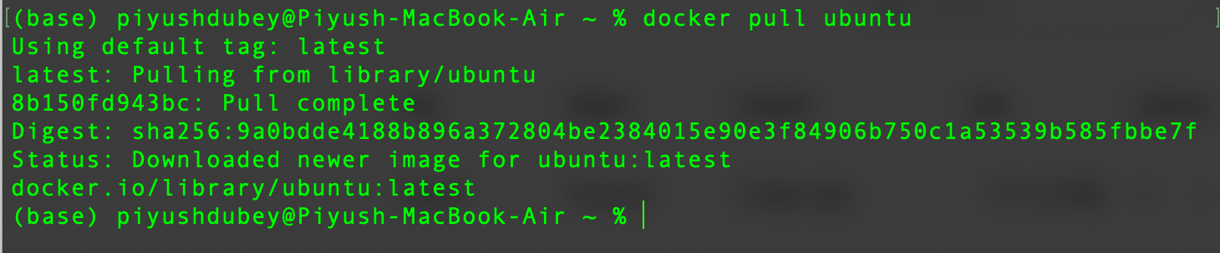
Q1.
g) Pull and list an image from the central repository.[5]
I pulled ubuntu image from docker , since it was already there so there was no need of extra downloads and it showed pull complete and next slide shows the list of all images in my pc .

Slide 9
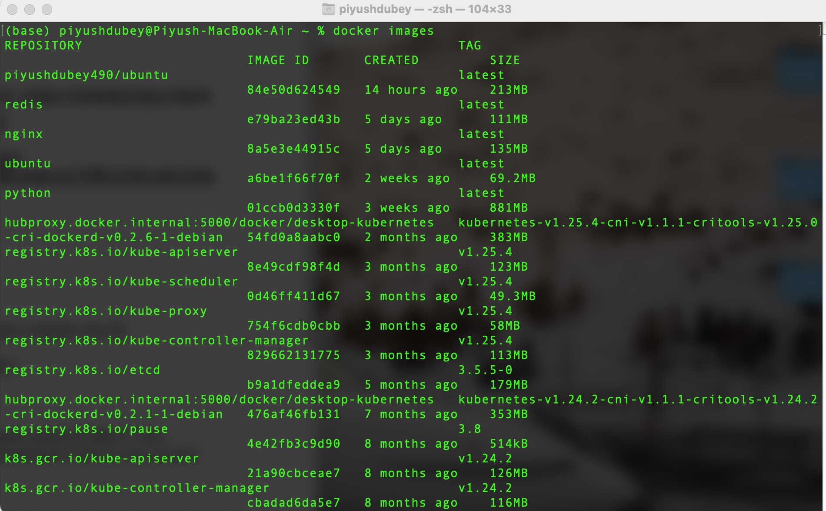

Slide 10
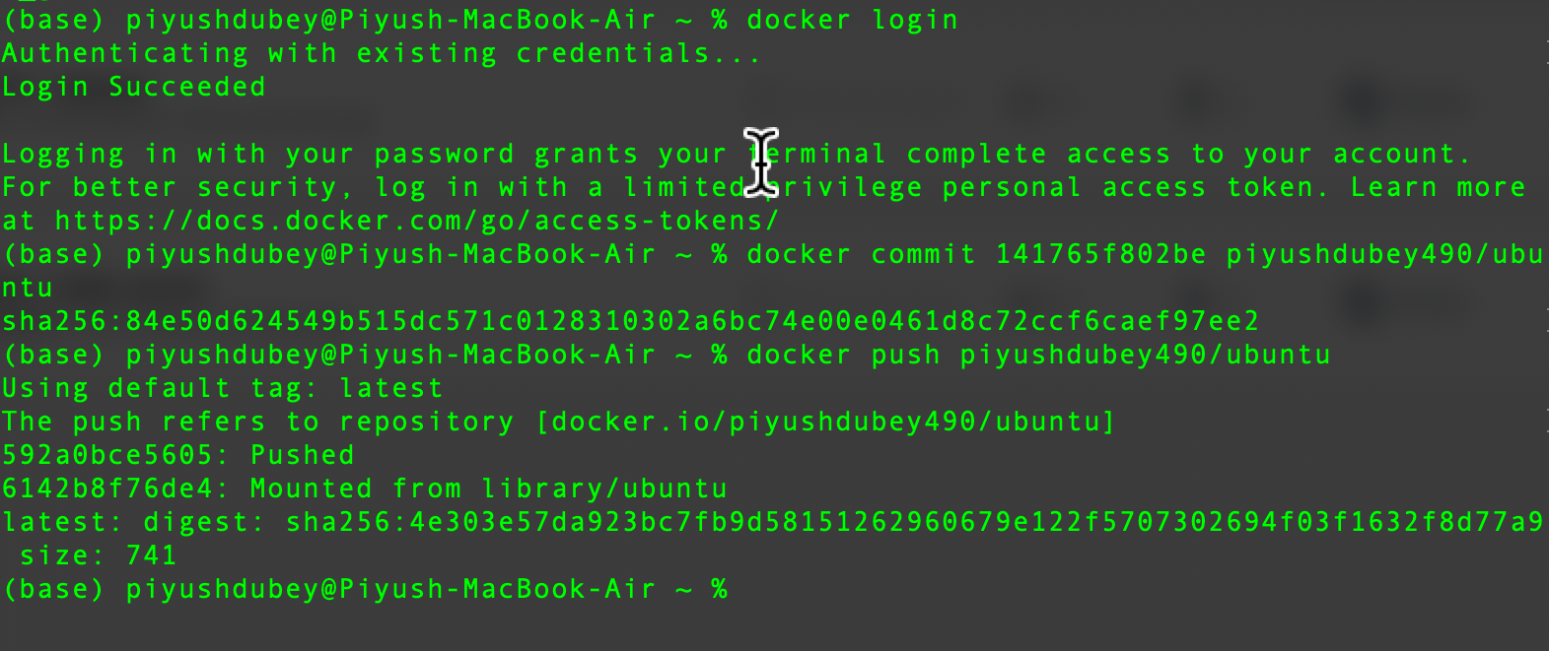
Q2. A developer wants to the following task: 1. Create a web container (abc) 2. Save changes to this container, and upload the same to your Dockerhub so that no one can pull the image.

Slide 11
I made a container and commit it and using docker login , after authenticating I pushed it to docker hub and since I made it private so no one pull it .

